Slide 1
超越学科界限的认知基础 Transdisciplinary Cognitive Foundation Recursion, Continuation, and CICD/DevOps Week 07
Ben Koo
October 26, 2020

Slide 2
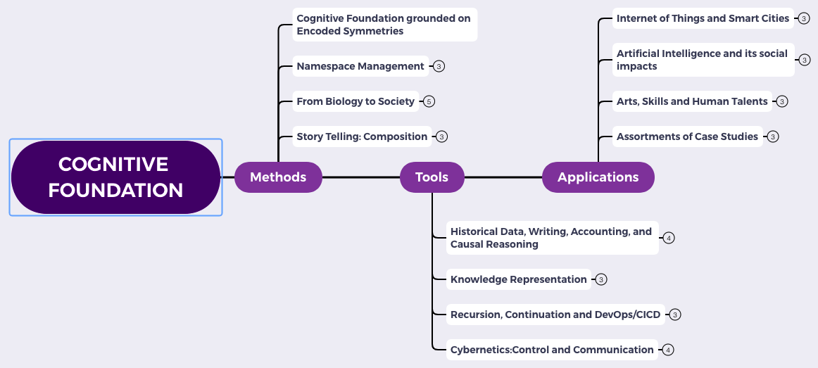
Content Themes for the semester
Overview
Namespace Management
Biology, Physics, Math, Code is Law, and Society
Story Telling, Functions/Metaphors/Analogies
Writing, Accounting, Historical Data and Temporal Reasoning
Knowledge Representation in Wiki and Files
Recursion and Continuation (DevOps/CICD)
Midterm Reports by Students
Cybernetics (Control and Communication)
Smart City and Internet of Things
Artificial Intelligence and its Social Impacts
Arts/Skills/Human Talents in the Digital Era
Student proposed Application Topics
Rehearsal
Final Reports and Celebration

Slide 3

Abstract Specification
Logic Model
Logic Model
Concrete Implementation
Context: Named Cognitive activities can be Computed at Scale
Goal: Show all computing process can be expressed in terms of Recursion
Criteria:
Consistent nomenclatures
Minimize cognitive complexity
Relate to societal practices
Output: An operational model for collective cognition
Process: Data Transformation activities
Input:
Theories on Recursive structures
Fundamental “bridging” analogies
Industrial practices at work
A well-defined set of Actions and iterative Branching Strategies
A Roadmap of composable activities
Sequencing and timing conditions
Explicitly state dependencies and resource requirements
Boundary Conditions: Farmilar with terminologies defined in previous lectures. i.e. Category Theory

Slide 4
Glossary
Ideas related to Knowledge Representation (week 6):
Partially Ordered Set (POS), Lattice, Initial and Terminal Objects, Limits, Co-limits.
Functors as Maps, Functors as Containers, Kan Extensions as Categories of Concepts
Static Analysis: Automatically discover properties for all possible paths of program execution
Terms to explain this week:
Recursive Functions: the source of complexity
Primitive Recursion: the ultimate standard for name management
Head and Tail Recursion: Trade offs between space and time

Slide 5
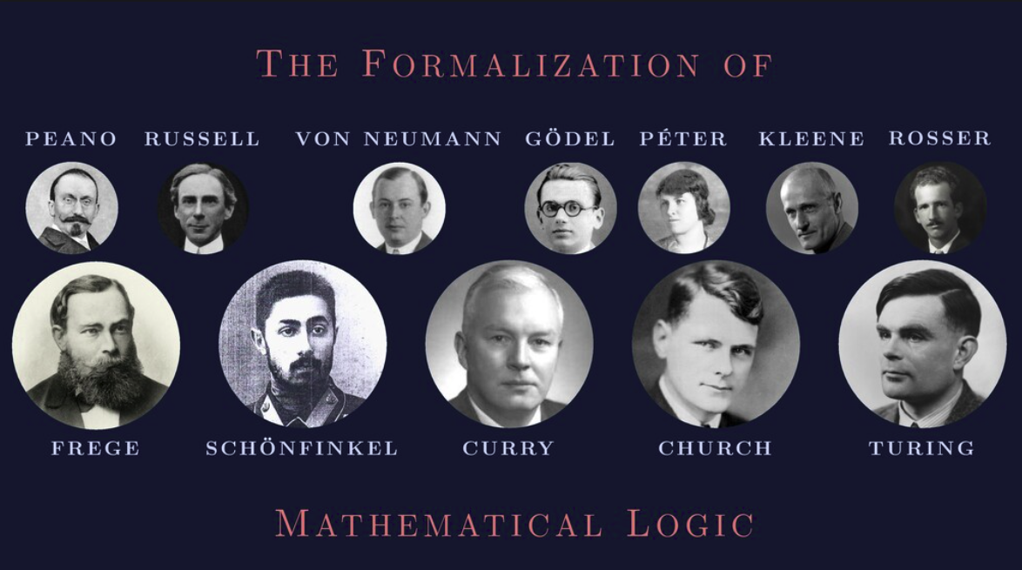
These Names are very useful to remember
Image Source: https://speakerdeck.com/glebec/lambda-calc-talk-frontside-version?slide=92

Slide 6
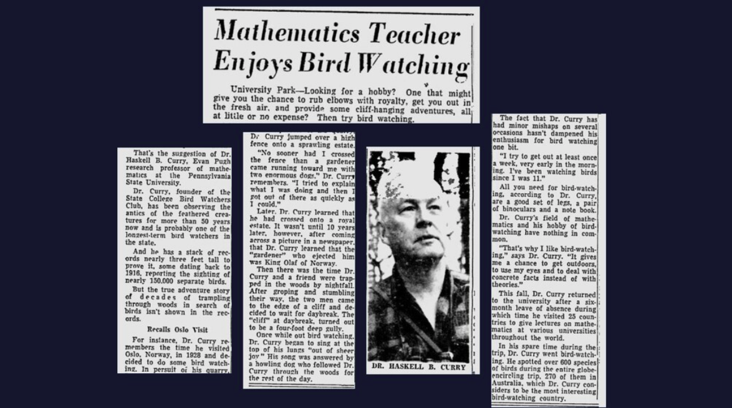
Name Management is a big deal
Image Source: https://speakerdeck.com/glebec/lambda-calc-talk-frontside-version?slide=90

Slide 7
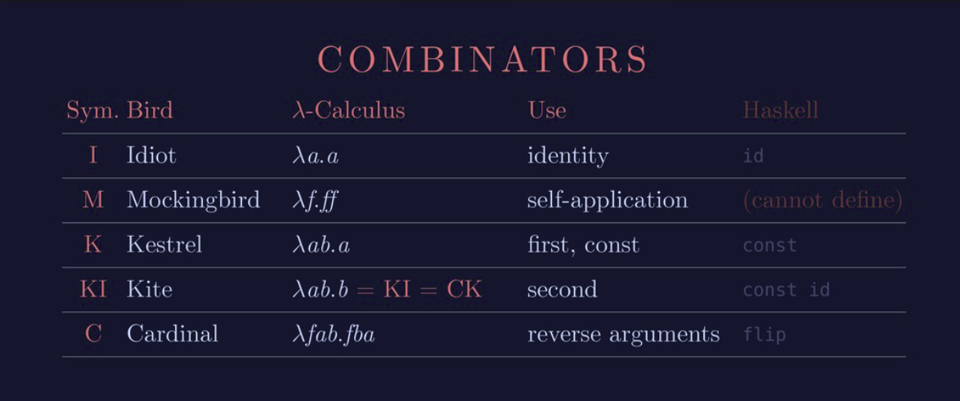
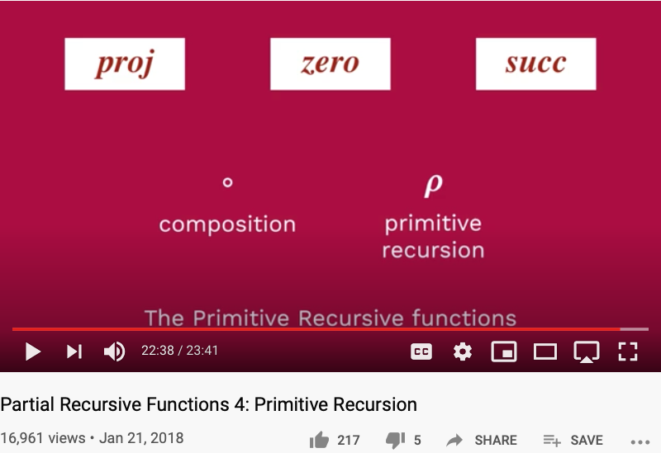
Five Critical Function Names
Idiot = identity = zero
Mockingbird = self-application = 𝜌
Kestrel = first, const = proj₁^{n}
Kite = second = proj₂^{n}
Cardinal = reverse arguments = a composition

Slide 8
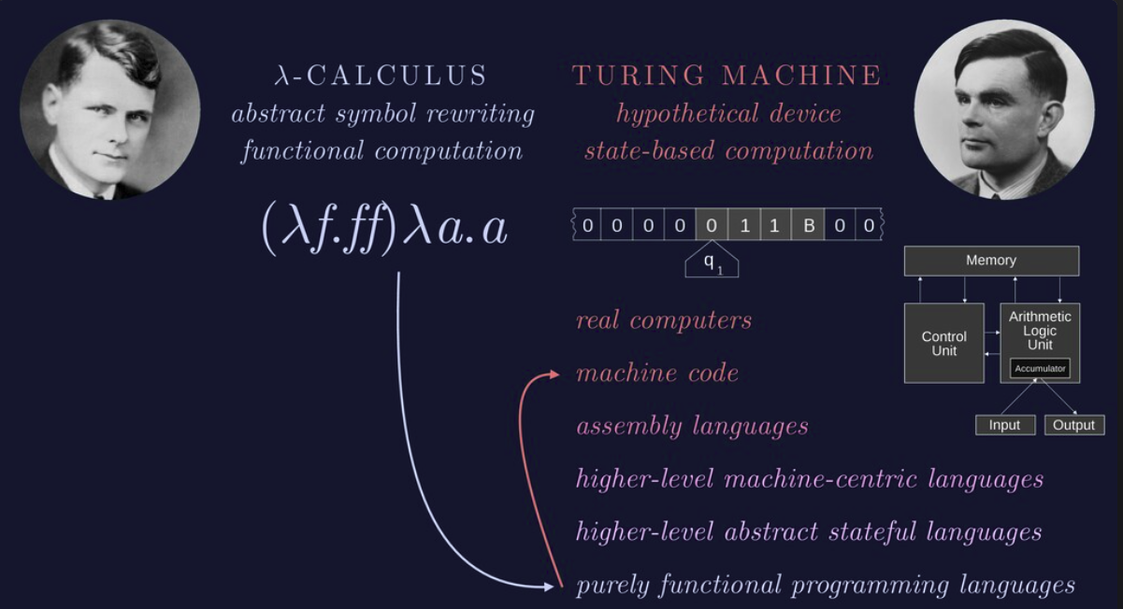
Lambda Calculus = Turing Machine

Slide 9
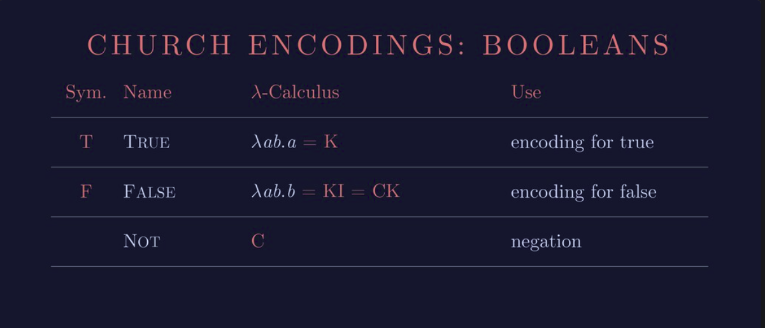
Lambda Calculus represents Boolean values
Huawei VP Mr. Yang Shaoqing
RICH 70 Tsinghua SEA Cloud Forum, Sep 14, 2020
H. E. Bambang Brodjonegoro,
Minister of Research & Technology, Indonesia

Slide 10

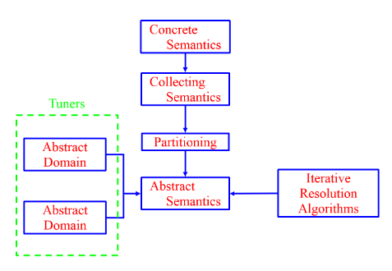
Recursion has Magic Powers
Multi-Level Recursion gives Practical Powers
Concrete Implementations can be realized using Galois Connections (a kind of recursion) introduced in Abstract Interpretation to automate verification and validatin activities.
Abstract Specification can be transformed into Primitive Recursive Functions based on Formal Methods and Model Checking Tools.
Image Source: Iowa State University: Wei Le

Slide 11
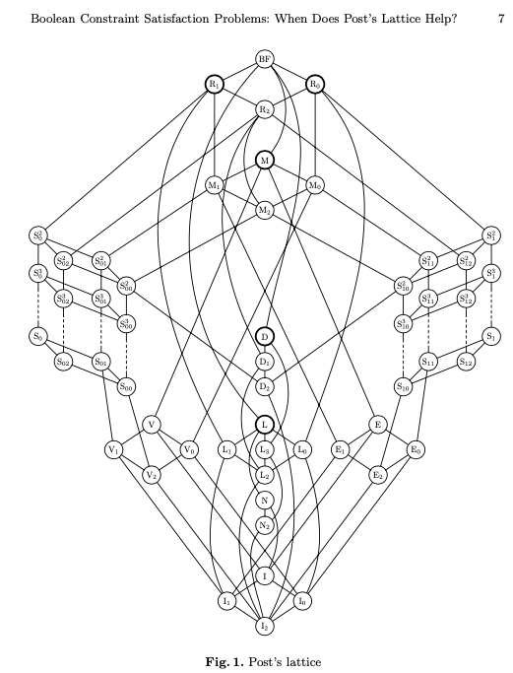
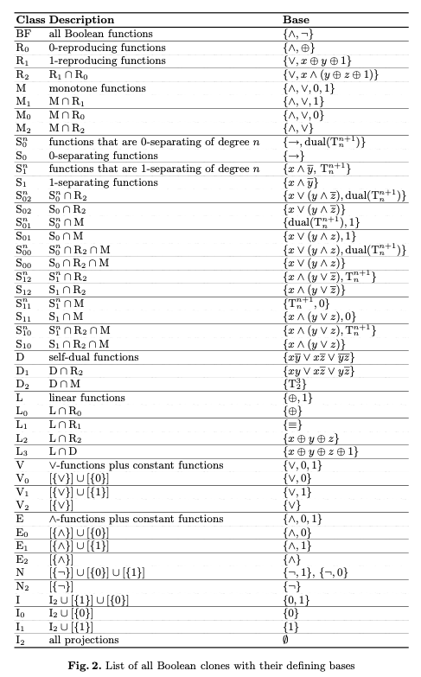
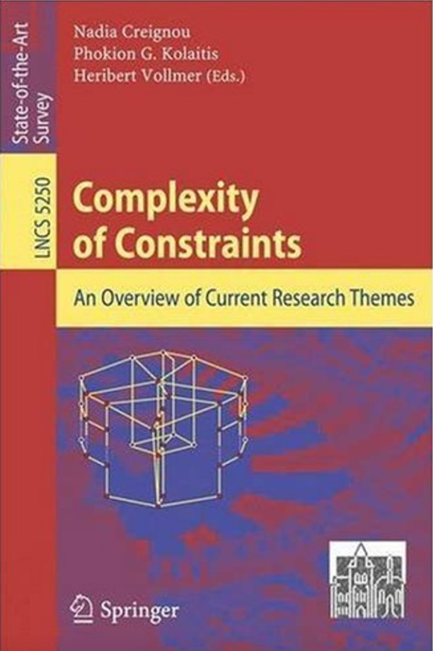
All Classes of Constraint Satisfaction Problems

Slide 12

The Master Algorithm that will rule the world?
Bill Gates recommended this book
in 2016 Code Conference
The thesis:
Processing data through a single universal learning algorithm— can get all the knowledge from the past, the present, and the future
Pedro Domingos, TMA, P. 25
Chinese Translation
12

Slide 13

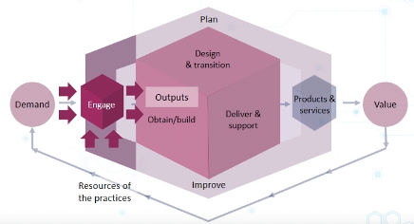
Abstract Specification
Concrete Implementation
A well-defined set of Actions and iterative Branching Strategies
A Roadmap of composable activities
Sequencing and timing conditions
Explicitly state dependencies and resource requirements
Namespace Management

Slide 14
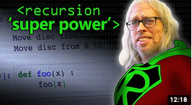
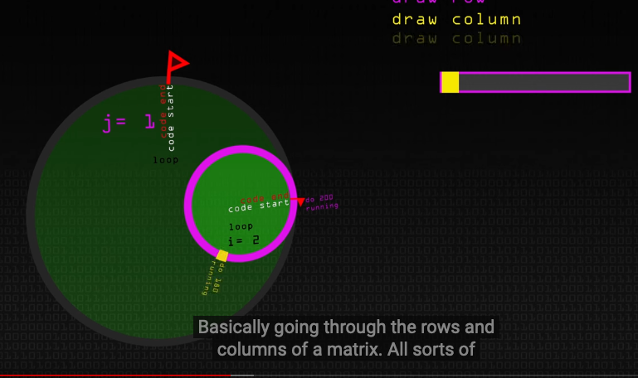
The Magical Power of Recursion
Huawei VP Mr. Yang Shaoqing
Video last viewed: October 26, 2020.
Video last viewed: October 26, 2020.

Slide 15
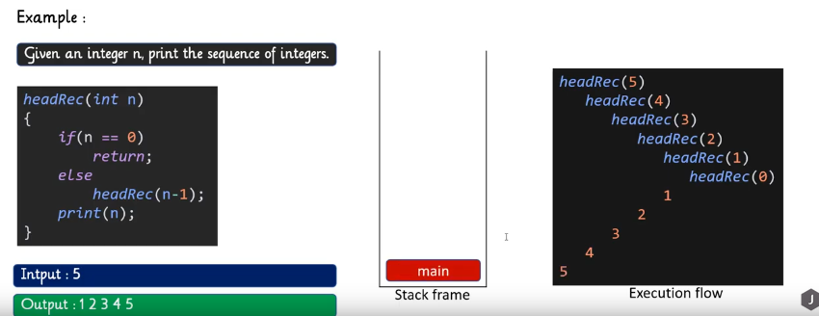
Head Recursion
Huawei VP Mr. Yang Shaoqing
Video last viewed: October 26, 2020.

Slide 16
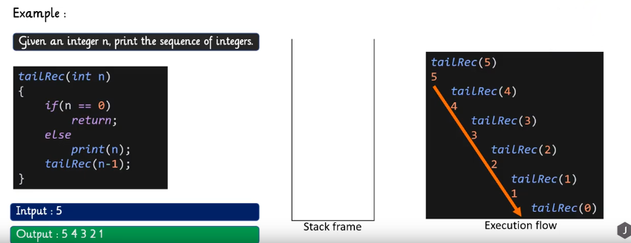
Tail Recursion
Huawei VP Mr. Yang Shaoqing
Video last viewed: October 26, 2020.

Slide 17
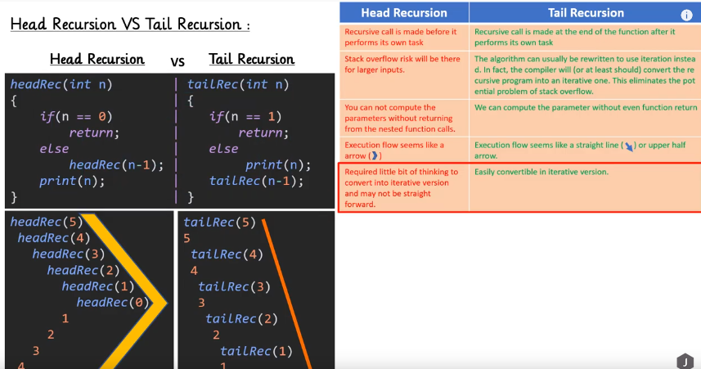
Comparing Head and Tail Recursion
Huawei VP Mr. Yang Shaoqing
Video last viewed: October 26, 2020.

Slide 18
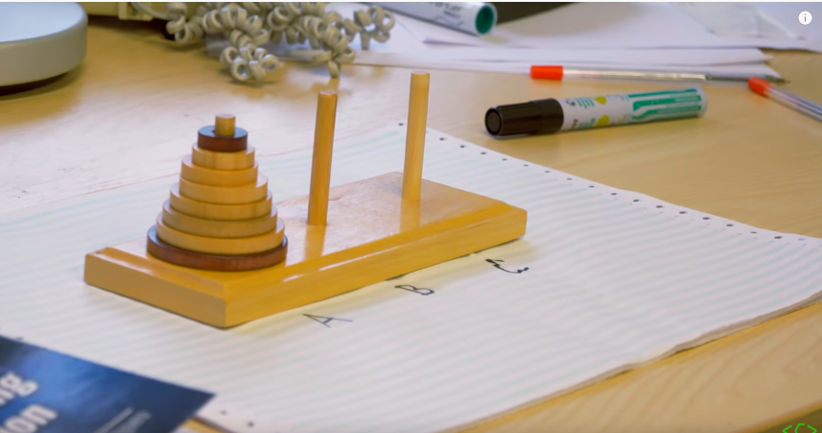
A Typical Example of Recursion
Huawei VP Mr. Yang Shaoqing
Video last viewed: October 26, 2020.

Slide 19
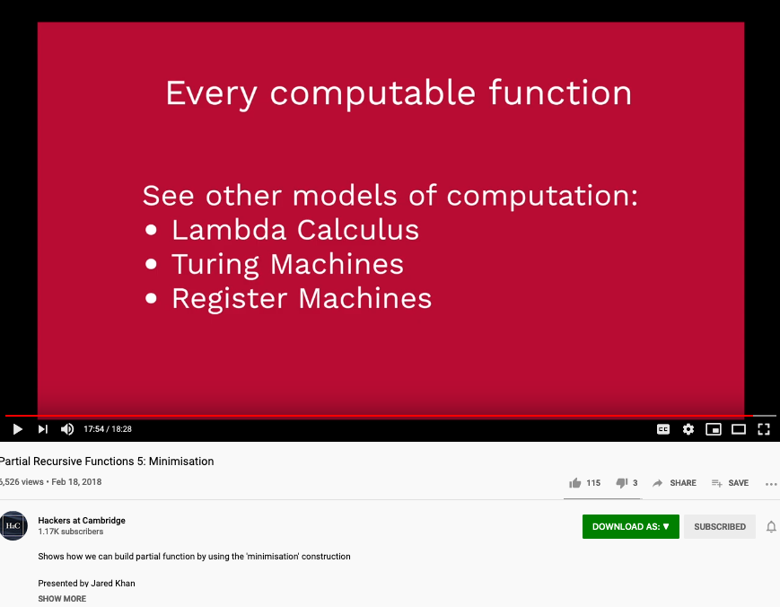
Primitive Recursion’s Universal Power
Huawei VP Mr. Yang Shaoqing
Video last viewed: October 26, 2020.

Slide 20
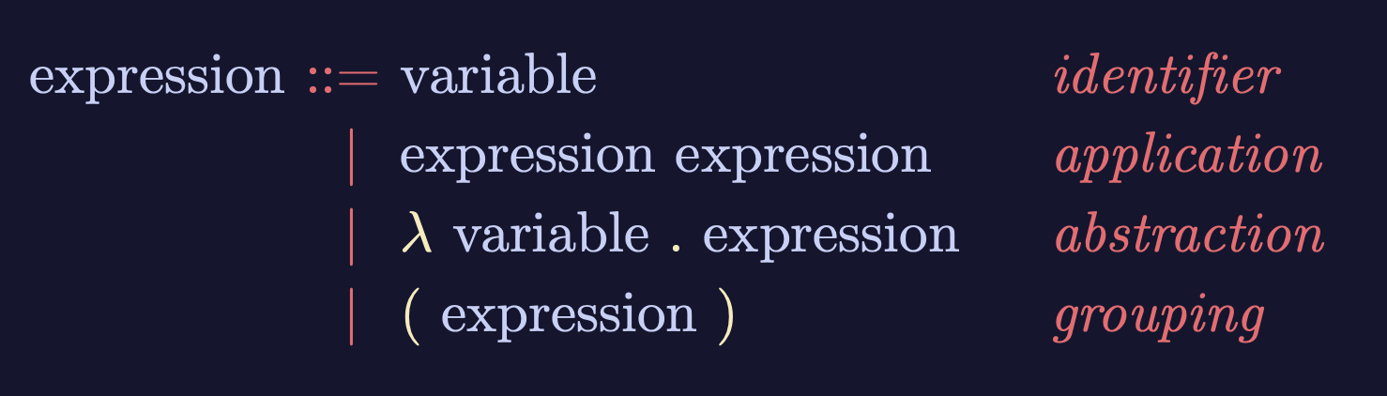
A Generalized Recursive Function
Image Source: https://speakerdeck.com/glebec/lambda-calc-talk-frontside-version?slide=66

Slide 21
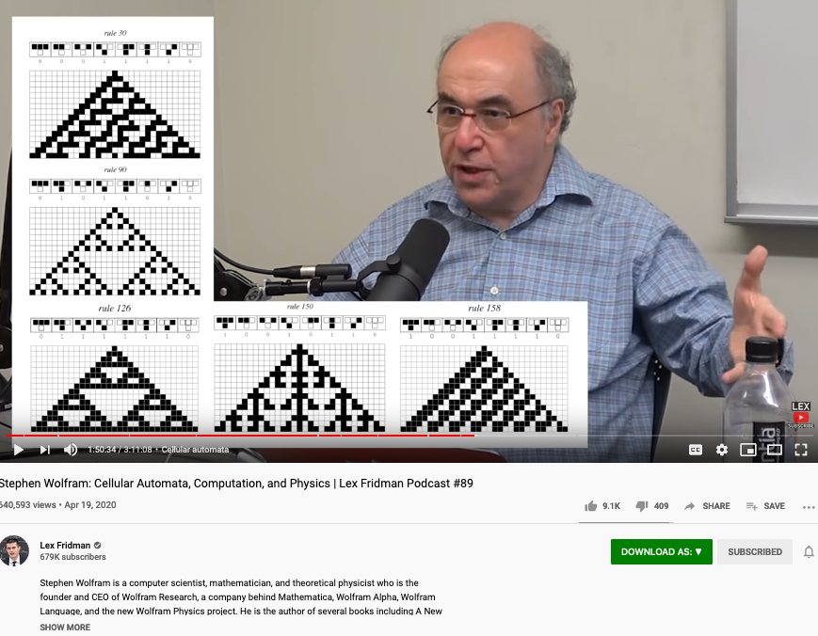
Discovering functions through enumerated function space
Huawei VP Mr. Yang Shaoqing
Video last tested: October 24, 2020.

Slide 22
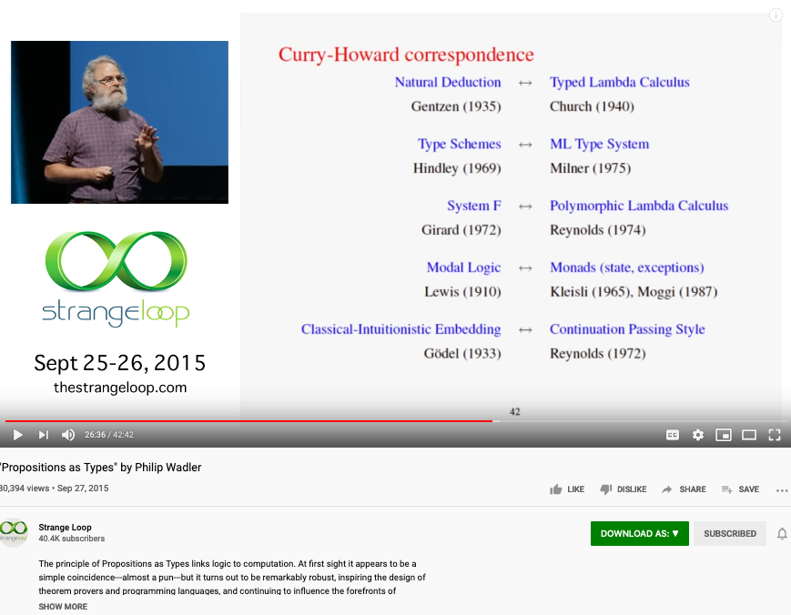
Is Math Proofs Invented or Discovered?
Huawei VP Mr. Yang Shaoqing
Video last tested: October 24, 2020.

Slide 23
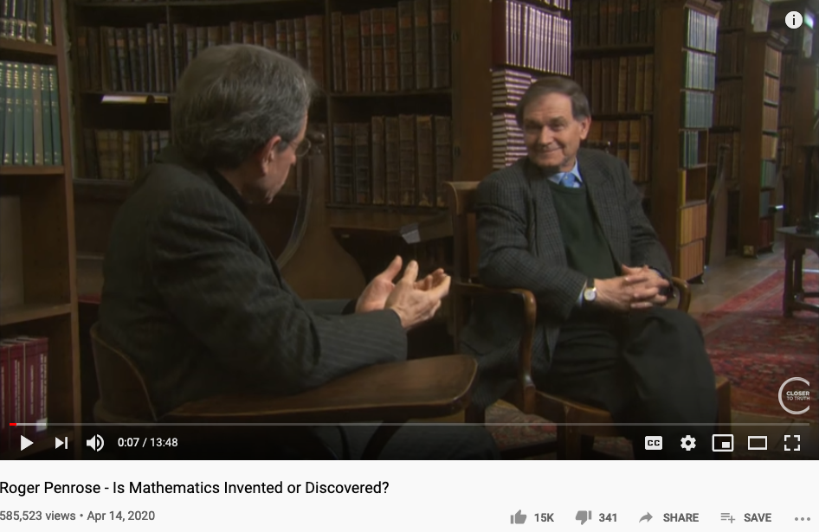
Is Math Invented or Discovered?
Huawei VP Mr. Yang Shaoqing
Video last tested: October 24, 2020.

Slide 24
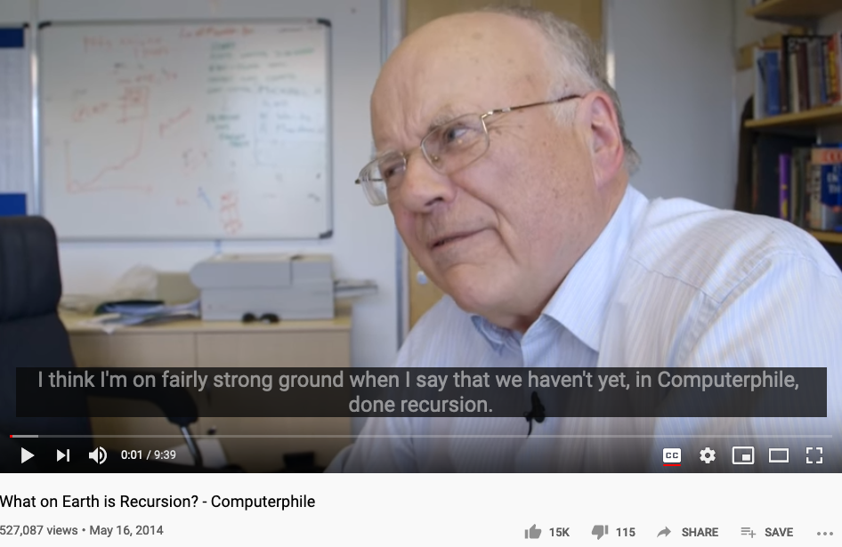
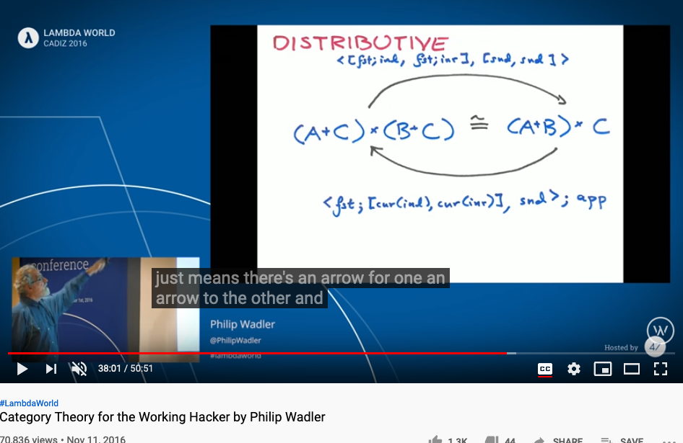
Is Recursion Invented or Discovered?
Huawei VP Mr. Yang Shaoqing
Video last tested: October 24, 2020.
Video last tested: October 24, 2020.

Slide 25

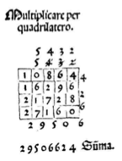
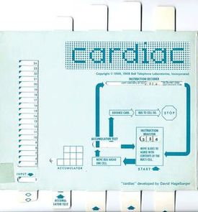
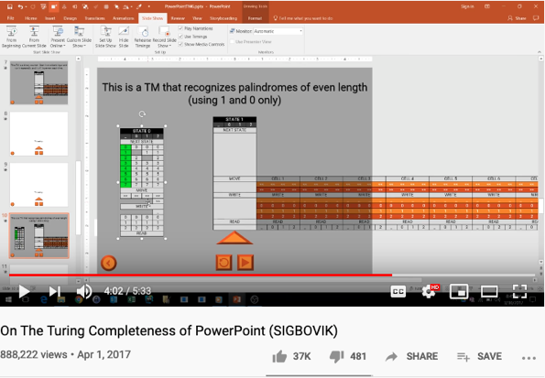
Computational Operations on Paper
https://youtu.be/uNjxe8ShM-8
A way to perform multiplication using matrix layout in Pacioli’s book.

Slide 26
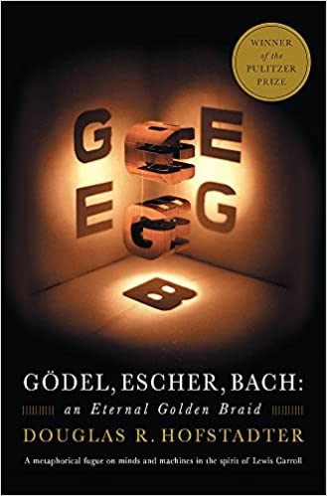


Metaphors and Story Telling

Slide 27
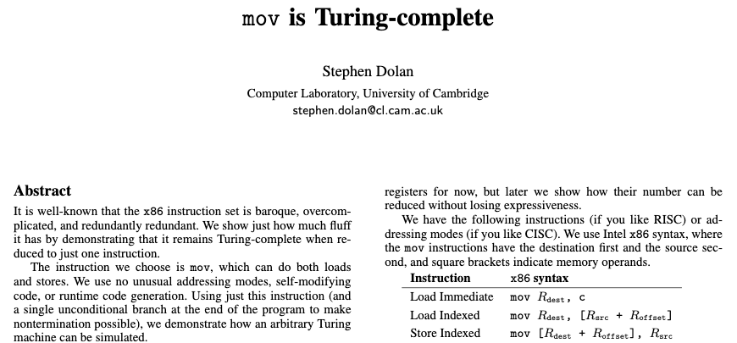
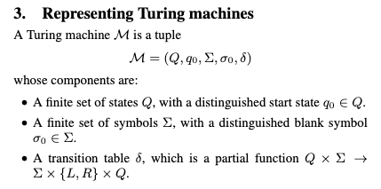
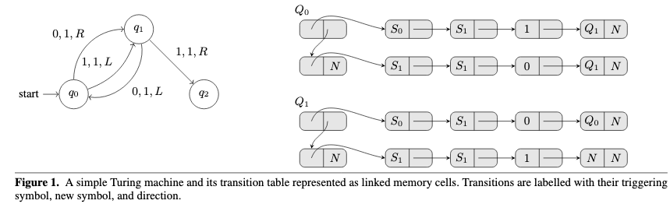
Turing Complete Instruction Set
Paper Download Link: https://drwho.virtadpt.net/files/mov.pdf

Slide 28
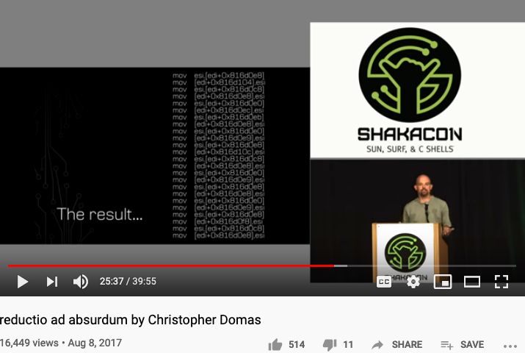
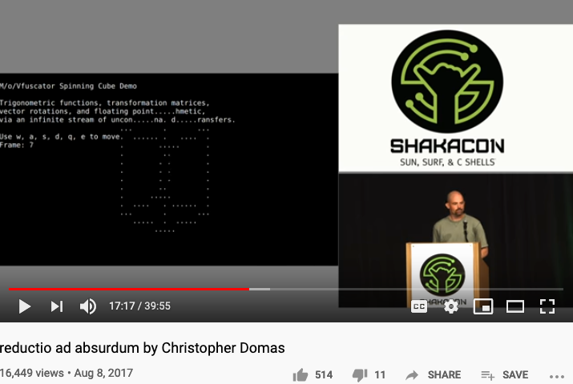
One instruction for All Computation
https://youtu.be/NmWwRmvjAE8?t=1037
Representing all computational actions with just one instruction, MOV

Slide 29
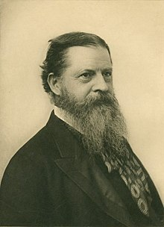
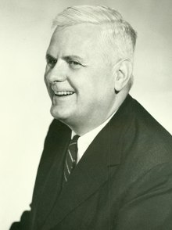
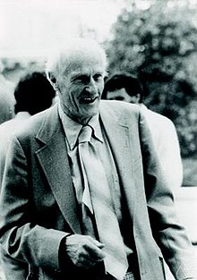
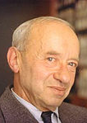

The Sources of these Ideas
Charles Sanders Pierce
Alonzo Church
Stephen Cole Kleene
Alfred Tarski
Dana Scott

Slide 30


Charles Sanders Pierce and Arrows
The NOR operator is also known as Peirce's arrow—Charles Sanders Peirce introduced the symbol ↓ for it,^{[1]}
Charles Sanders Pierce

Slide 31
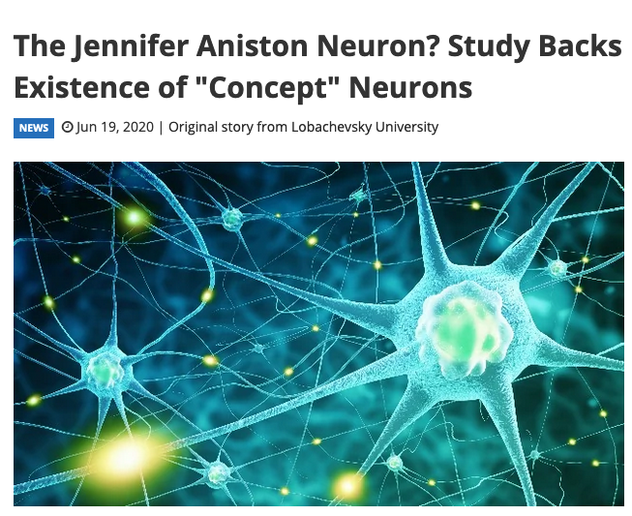
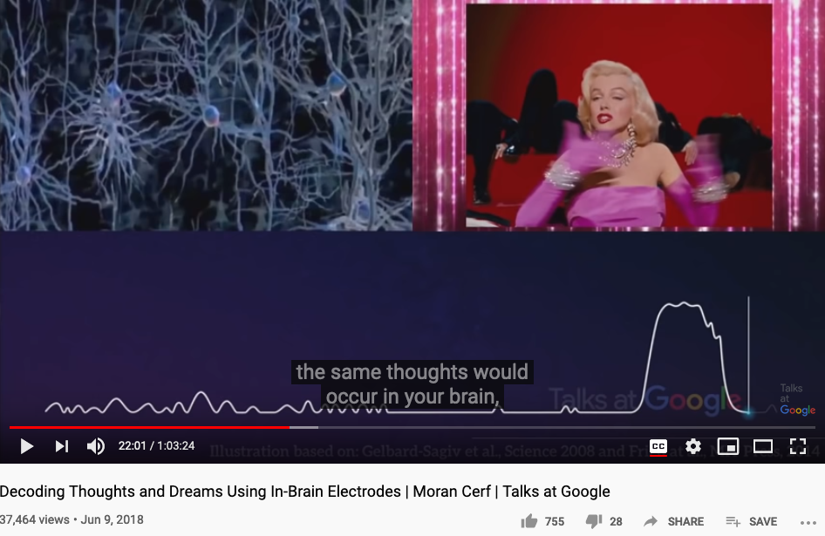
Charles Sanders Pierce and Arrows
The web report
Google Talk 2018 by Moran Cerf

Slide 32
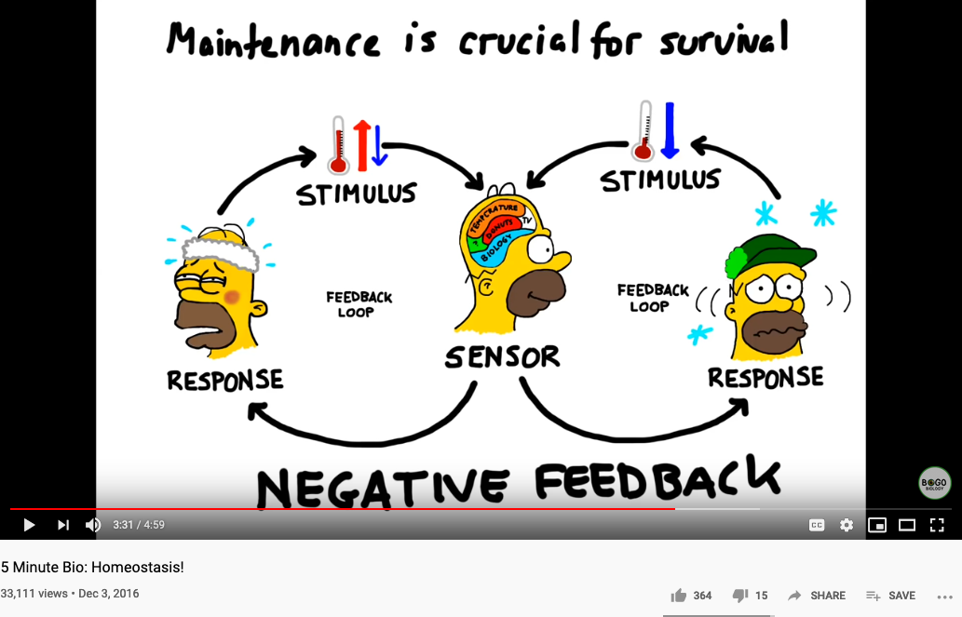
Biology and Physiology

Slide 33
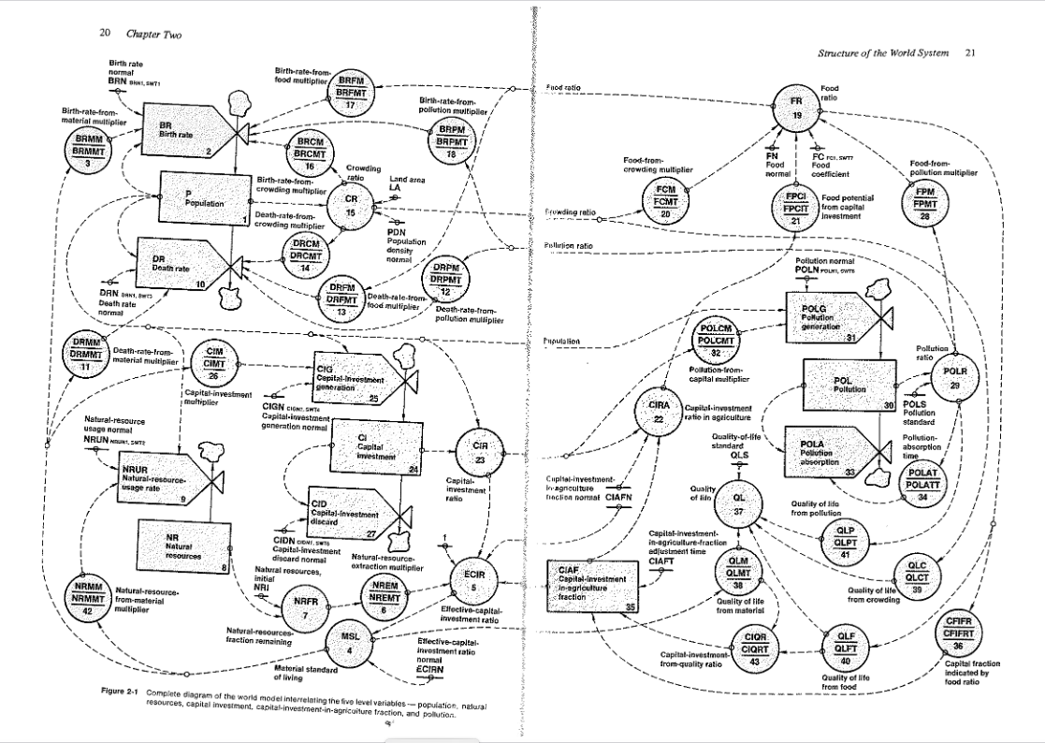
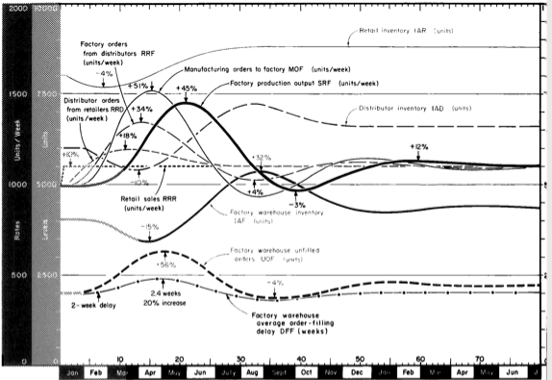
Industrial and World Dynamics
The World is made of three kinds of things:
Stock, Flow, and State variables parameterized in time

Slide 34
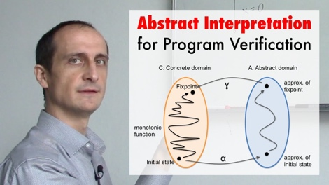
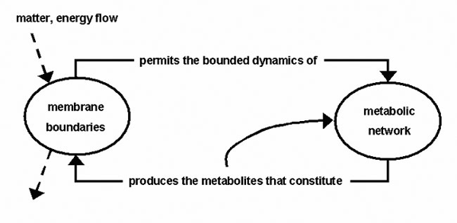
NsM under a Biological/Economic Control System
Image Source: From autopoiesis to neurophenomenology: Francisco Varela's exploration of the biophysics of being,
DAVID RUDRAUF, ANTOINE LUTZ, DIEGO COSMELLI, JEAN-PHILIPPE LACHAUX, and MICHEL LE VAN QUYEN

Slide 35

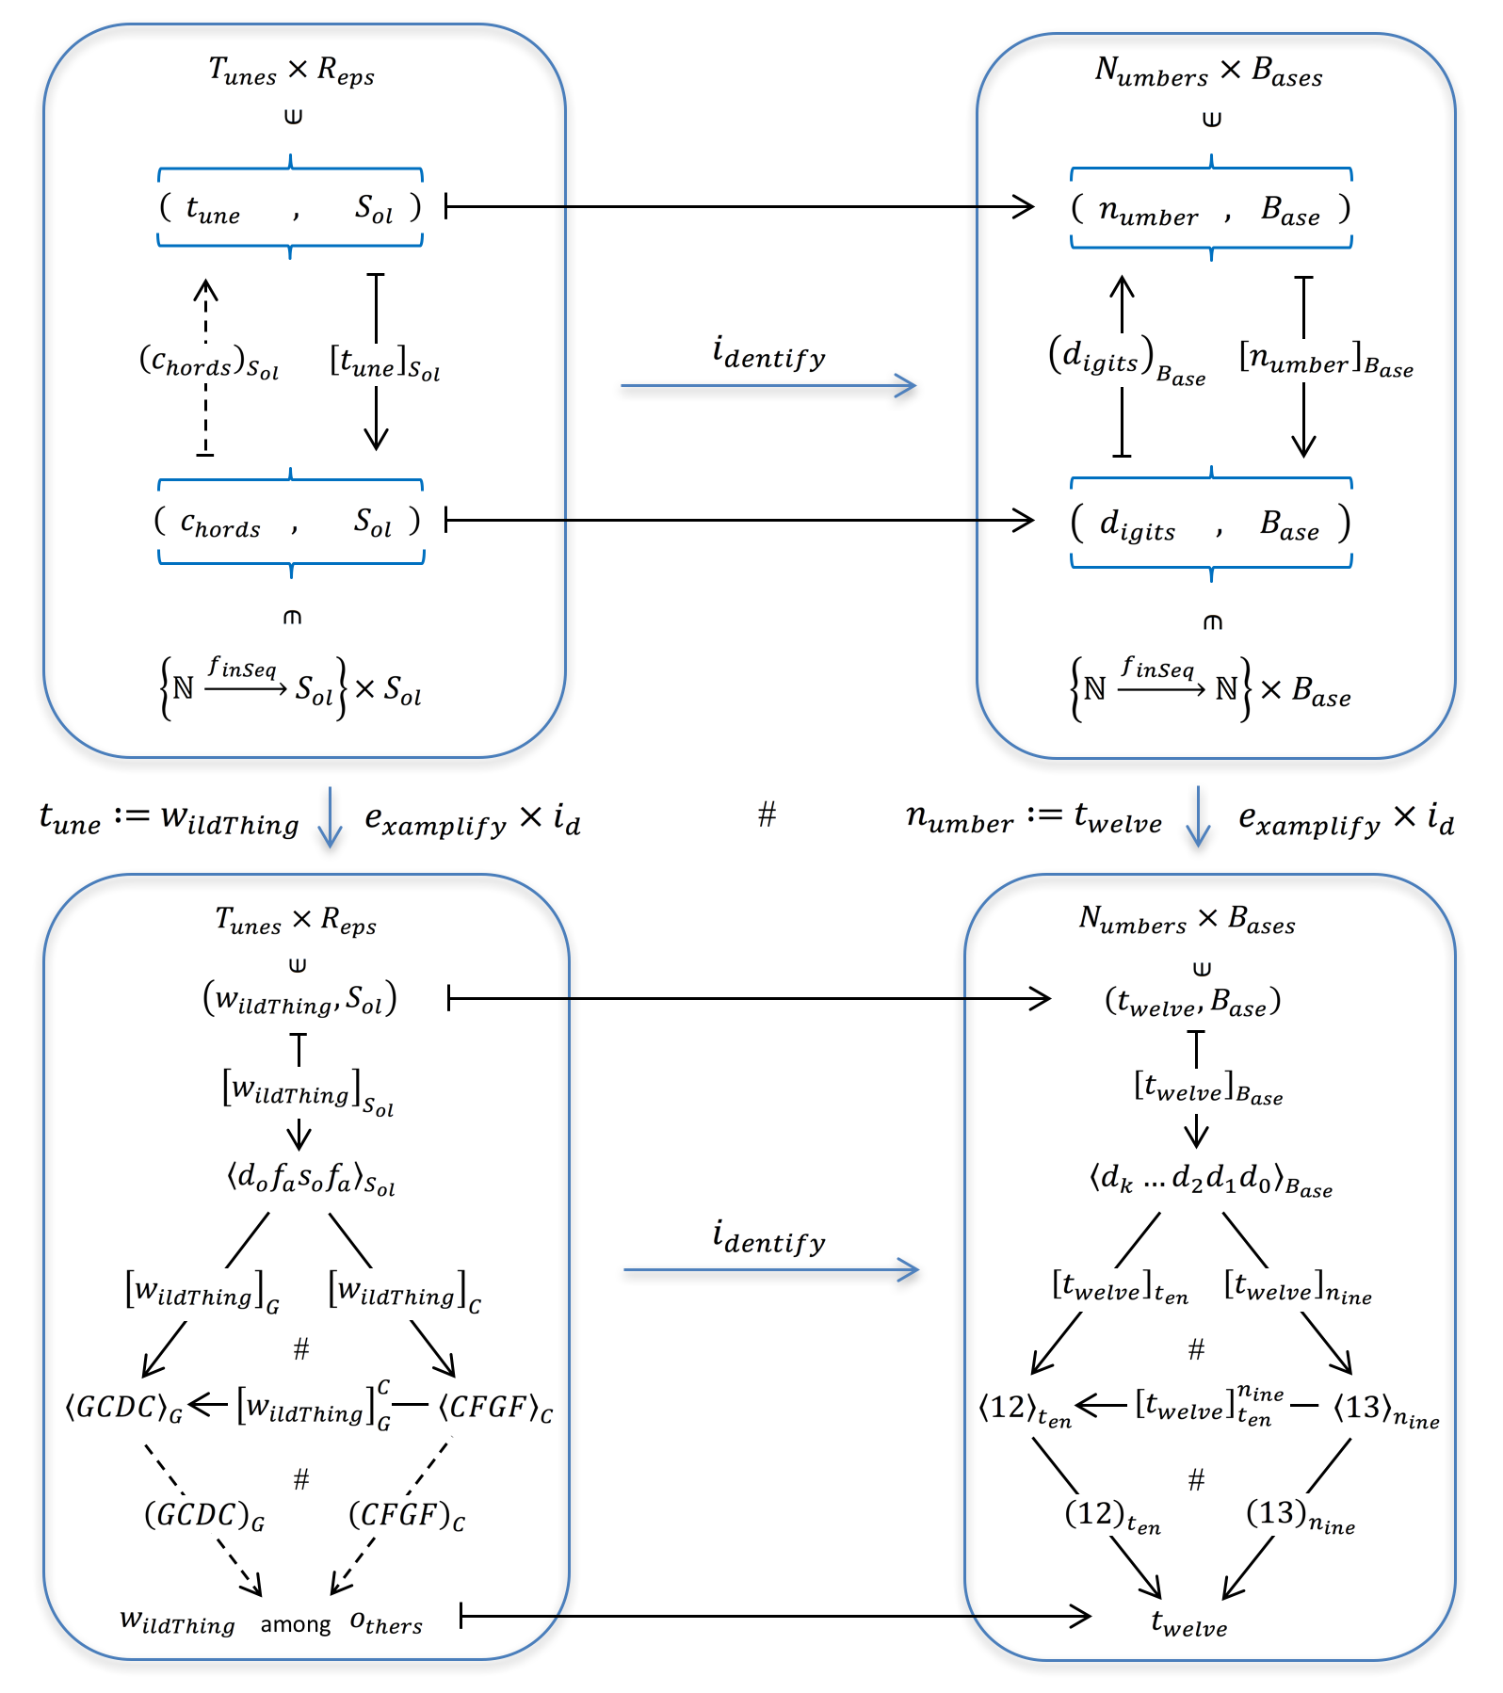

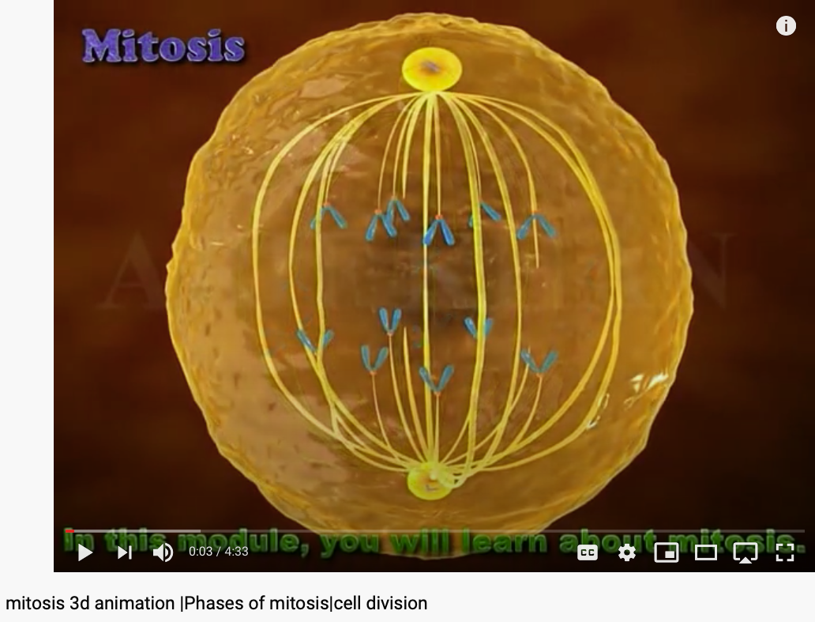
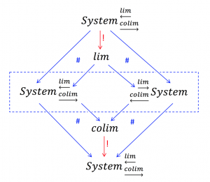
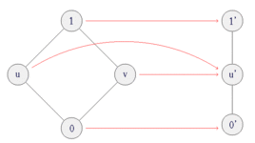
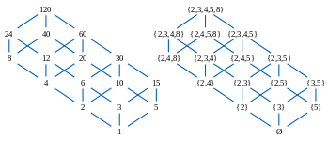
All System can be approximated as Partially Ordered Set
Numbers are naturally related to Music:

Slide 36

A Categorical Manifesto
Welcome to the web site of the KMR group! We are based at the School of Electrical Engineering and Computer Science EECS [formerly (= pre 2018) the School of Computer Science and Communication] (CSC) at the KTH Royal Institute of Technology in Stockholm, Sweden.
… the Fifth Dogma:
Given a category of widgets, the operation of putting a system of widgets together to form some super-widget corresponds to taking the colimit of the diagram of widgets that shows how to interconnect them.
At least for me, this dogma first appeared in the context of General Systems Theory.
////// End of quote from Joseph Goguen’s Categorical Manifesto

Slide 37

The ”POS” of knowledge representation by KMR
Image Source: KMR group of KTH Royal Institute of Technology in Stockholm, Sweden.

Slide 38

A Must Watch Video on Monad
https://youtu.be/OSuu8zBBNAA?t=857

Slide 39

Abstraction
Concretization
Serve as the Control Plane
Define Policies according to high level objectives
Security roles protected by tech not by political influence only
Law enforcement by controlling targeted resources in the Data Plane
Serve as the Data Plane
Resources governed by Configurable Policies
Security-sensitive infrastructure that assigns traceable responsibilities to persons
Provide feedback from real worlds to reflect on the efficacies of laws
A well-defined set of Actions and iterative Branching Strategies
A Roadmap of composable activities
Sequencing and timing conditions
Explicitly state dependencies and resource requirements
Namespace (Data Asset) Management

Slide 40


Reserved Names and Constants in Sciences
Unzicker’s Observations:
Revolutions in physics have always eliminated arbitrary numbers
A complete theory of reality must do without any constants of nature
https://youtu.be/zxAV_Re4OWA?t=239
https://youtu.be/zxAV_Re4OWA?t=323
On the origin of constants C and h, by Alexander Unzicker, last accessed Oct 20, 2020

Slide 41
Concrete Activities in Daily Workflow
What is DevSecOps?
Image courtesy: Paladion Corporation Website Image source: https://www.paladion.net

Slide 42


Unified Namespace

Slide 43


Get access to Live Data Now!
https://www.flightradar24.com/
https://www.marinetraffic.com/

Slide 44



An example of Namespace Management

Slide 45


Namespace Management in Time

Slide 46



Diffbot (more than 1 Trillion linked entities)

Slide 47


The Complete set of Generative Names
Huawei VP Mr. Yang Shaoqing
RICH 70 Tsinghua SEA Cloud Forum, Sep 14, 2020
H. E. Bambang Brodjonegoro,
Minister of Research & Technology, Indonesia

Slide 48

Number Theory, Physics, and Geometry
Huawei VP Mr. Yang Shaoqing
RICH 70 Tsinghua SEA Cloud Forum, Sep 14, 2020
H. E. Bambang Brodjonegoro,
Minister of Research & Technology, Indonesia
Ninhyong Kim has been a research professor of number theory at the University of Oxford and the head of their number theory research group.

Slide 49

The origin of Atomic Elements
Huawei VP Mr. Yang Shaoqing
RICH 70 Tsinghua SEA Cloud Forum, Sep 14, 2020
H. E. Bambang Brodjonegoro,
Minister of Research & Technology, Indonesia

Slide 50


The known set of Elementary Particles
Huawei VP Mr. Yang Shaoqing
RICH 70 Tsinghua SEA Cloud Forum, Sep 14, 2020
H. E. Bambang Brodjonegoro,
Minister of Research & Technology, Indonesia

Slide 51

The way medical doctors talks about Human Anatomy
Huawei VP Mr. Yang Shaoqing

Slide 52


How mathematicians and musicians talks about Music
Huawei VP Mr. Yang Shaoqing
RICH 70 Tsinghua SEA Cloud Forum, Sep 14, 2020
H. E. Bambang Brodjonegoro,
Minister of Research & Technology, Indonesia

Slide 53

A Way to Get Internet Domain Name Service
Huawei VP Mr. Yang Shaoqing

Slide 54


NsM in Loops and Recursion

Slide 55


Another Round at Recursion

Slide 56

Lecture Outline

Slide 57

Arts and Sciences of NsM
History of Names
Patterns of Names
Trust-worthy Names
Namespace management is the Cognitive Foundation.

Slide 58


Names gave birth to Cognitive Abilities - Laozi
Huawei VP Mr. Yang Shaoqing
RICH 70 Tsinghua SEA Cloud Forum, Sep 14, 2020
H. E. Bambang Brodjonegoro,
Minister of Research & Technology, Indonesia

Slide 59



The History of True Names
Huawei VP Mr. Yang Shaoqing
RICH 70 Tsinghua SEA Cloud Forum, Sep 14, 2020
H. E. Bambang Brodjonegoro,
Minister of Research & Technology, Indonesia
How Gods are forgotten:
https://youtu.be/xgyMY9w7-ew?t=278

Slide 60


The Meaning of being True
Huawei VP Mr. Yang Shaoqing
RICH 70 Tsinghua SEA Cloud Forum, Sep 14, 2020
H. E. Bambang Brodjonegoro,
Minister of Research & Technology, Indonesia
Russel once said: “Mathematicians’ job is about classifiying.”
Mathematics is the art of giving the same name to different things.^{[10]} Henri Poincaré

Slide 61


The Necessity of Named abstractions
Huawei VP Mr. Yang Shaoqing
Through abstraction, only compute truth within the domain of interest!
So that it can by pass the Halting Problem.

Slide 62

True Name defined by Wikipedia

Slide 63




Labels, Linguistics, and Cognitive Science
Image Source: https://georgelakoff.com/

Slide 64



The expressive power of Names (labels)
Huawei VP Mr. Yang Shaoqing
Prof. George Lakoff

Slide 65

Categories are Containers of cognitive concepts
Huawei VP Mr. Yang Shaoqing

Slide 66


Names as Generalized Metaphors
Huawei VP Mr. Yang Shaoqing
RICH 70 Tsinghua SEA Cloud Forum, Sep 14, 2020
H. E. Bambang Brodjonegoro,
Minister of Research & Technology, Indonesia

Slide 67



“Mathematics is the art of giving the same name to different things!” - Henry Poincare

Slide 68


The monad, about which we shall speak here, is nothing other than a simple substance which enters into compounds, ‘simple’ meaning ‘without parts’. - Leibniz
Monad: Leibniz’s Universal Abstraction Unit

Slide 69

Automation approximates and enables Process Continuity
Image courtesy: Learn How to Set Up a CI/CD Pipeline From Scratch from DevOps Zone

Slide 70

What is DevOps? Development and Operations
Image courtesy: Riyaz Hyder on Botmetric November 2, 2017

Slide 71

Not Information Asymmetry, but promote the Principle of Information Symmetry

Slide 72

Open and then Free
Open Source
Right to use publicly available technologies and other resources in the learning process
Right to resolve conflicts in a dynamic context in digitized space
Freedom to make decisions related to one’s personal digital assets
Freedom to express one’s opinions
Free Software
Founder of Free Software Foundation, and Creator of GNU/Linux. Image credit: Wikipedia
Paraphrased from “Free Software, Free Society” by Richard Stallman

Slide 73


Service Mesh (Istio) and Human Physiology Checks and Balances Data Plane and the Control Plane
Data Plane
Control Plane
Data Plane
Control Plane

Slide 74

Awareness at many levels

Slide 75
Governance in Cyber-Physical Spaces
John Locke’s Theory of Governance
All Men(Persons) are Created Equal
Certain Basic Rights Exists Independent of Government
Government Exists to Protect those Rights
Cyberspace Governance
All User Accounts can be Equally Created
Users may do anything Independent of Cyber-Government
Cyber-Government exists to enable user rights without Breaking the Cyber-Physical System
System Engineering | John Locke | Cyberspace
Correctness | All Men are Created Equal | All Accounts are Created Equal
Liveness | Certain Basic Rights exists Independent of Government | User actions are Independnet of Cyber Governance
Safety | Government exists to Protect those Rights | Cybersecurity exists to prevent users break the System

Slide 76







DevOps for Smart Cities

Slide 77

DevOps Goals for Governance
Notes:
1. 對稱性是底層的不變性
2. 在Cyberspace上，數據、操作數據的方式、操作數據的基礎架構，是資產的根本
3. 邏輯模型是凝聚群體意識的有效框架
4. Devops 能夠高效實現不同規模的Logic Model, 藉由（不同層次）數據可視與可控

Slide 78




Cyber-Physical Space Integration
Public Domain Data
Smart Contract Data
Private
Data
Notes:
1. 對稱性是底層的不變性
2. 在Cyberspace上，數據、操作數據的方式、操作數據的基礎架構，是資產的根本
3. 邏輯模型是凝聚群體意識的有效框架
4. Devops 能夠高效實現不同規模的Logic Model, 藉由（不同層次）數據可視與可控

Slide 79


The CAP Theorem in NsM
RICH 70 Tsinghua SEA Cloud Forum, Sep 14, 2020
H. E. Bambang Brodjonegoro,
Minister of Research & Technology, Indonesia

Slide 80



Name Spaces in Databases
RICH 70 Tsinghua SEA Cloud Forum, Sep 14, 2020
H. E. Bambang Brodjonegoro,
Minister of Research & Technology, Indonesia

Slide 81





We are in the Universe, now!
Library of
Linked Knowledge
(Data Plane)
Library of Executable Algorithms
(Control Plane)

Slide 82







Abundant Tools and Data Sources can all be accessed through Web Browsers

Slide 83
Namespace Management should be operated under the Principle of Information Symmetry
Natural & Structural Symmetry: Space, Time, Energy
Data Content Symmetry: Immutable Data Service
Functional Symmetry: Algorithmic Consistency
Infrastructure Symmetry: Trust-worthy System Support
Knowledge Symmetry: Equality in Information Interpretation
Notes:
1. 對稱性是底層的不變性
2. 在Cyberspace上，數據、操作數據的方式、操作數據的基礎架構，是資產的根本
3. 邏輯模型是凝聚群體意識的有效框架
4. Devops 能夠高效實現不同規模的Logic Model, 藉由（不同層次）數據可視與可控

Slide 84

Discussion and Future Applications
Past Known efforts
Alternative Strategies?
Other Applications?
Round Table Discussion

Slide 85

Lets go back to the birth place of the World Wide Web!
Conclusion
Far
Space
near
It is all made of Names!
before Time after

Slide 86
Your action on NsM before Sep 28, 202
Start using Templates and Categories on toyhouse.wiki:81
Create a personal page with bio, using standardized Templates and Category
Make sure all Wiki pages you created follow the same Namespace convention
Start using Github to download and share files with proper NsM
Couse Github @ https://github.com/benkoo/CognitiveFoundation2020
Start writing your learning report.
Every week should include Logic Model using the standard Template
500 words or more per week

